Slide 1

The next generation tester!
To Softec – Silicon India attendees
With love,
Pradeep Soundararajan
Director @ Moolya Software Testing Private Limited
ps@moolya.com / www.moolya.com

Slide 2


Agenda for my talk
Not to change you (So, feel safe and relaxed)
Not to say, I am better than you. (So, feel a lot safer)
Not to bore you (intentionally, I mean)
Not to waste your time ( really not )
Not too many slides (just 16)
Maybe I could talk things that might interest you.
Not sure though

Slide 3
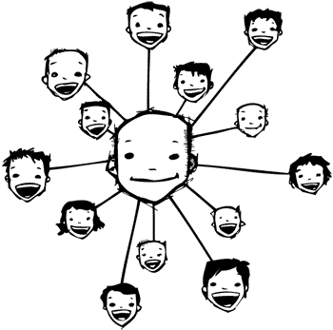
Acknowledgements!
If I am smart, it is not only because of me, the people with whom
I associate matter and they are… Jerry Weinberg, Cem Kaner, James Bach, Michael
Bolton, Jon Bach, Ben Simo, Thomas Alva Edison, Vishnusharma, Birbal, Vipul Kocher,
Parimala Shankaraiah, Sharath Byregowda, Shrini Kulkarni, Santhosh
Tuppad, Edward De Bono, Malcom Gladwell, Mohan Panguluri, the Weekend Testing
folks, the Context Driven Testing folks, the AYE conference folks, the BWST folks, the
Writing about Testing folks, folks at STC & TR, LinkedIn ST&QA group …

Slide 4

What is happening in Area 51?

Slide 5

Next gen tool : 1
This tool is called the “Quick Code Pro”
This tool can write code faster than developers.
This tool can write same code more than once.
This tool can write code for bug fixes.
This tool can do the job of several hundred programmers in just five seconds.
This tool license is less expensive than hiring developers.

Slide 6
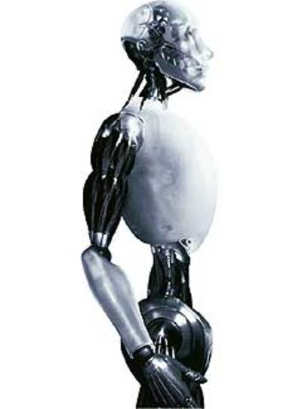
The next, next gen tool : 2
This tool is called “iRitational Test Manager Robot”
This tool can take faster decisions than your manager.
This tool assesses the risk of a product faster than a few test managers put together
They are cheaper than hiring a test manager
They are tester friendly ( reduces attrition )

Slide 7

The next, next, next gen tool : 3
This tool is called “Auto CEO”
This tool does the strategy
This tool understands the change needed to bring in to be able to remain competitive in the market.
This tool is much inexpensive compared to hiring and retaining a CEO
You can have an updated version every three months.
Very simple to operate: Just record one day of what your CEO does and replay it several times across the week.

Slide 8
If all that sounded funny? How about this?
XYZ test automation tool reduces the test cycle execution time by >50%
XYZ tool can run tests that humans can, just record and play how many ever times you want.
XYZ tool can work out to be cheaper over a longer period. ( cheaper compared to hiring humans )
The people you need in your organization is not the one who knows how to test but operators of XYZ
Write a robotic script that humans need to perform, then automate it and call it “test automation”

Slide 9
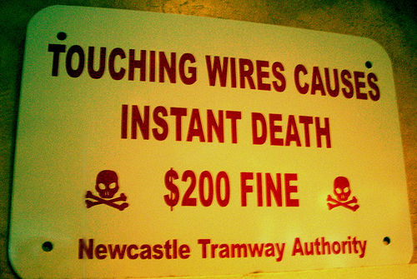
Practically stupid!
Why did automating CEO work sound funny and stupid?
Why did automating programmers work sound funny and stupid?
Why doesn’t automating testers testing work sound funny and stupid?

Slide 10
The traps that current generation testing folks are in
The “difference between” trap.
The “nothing but” trap
The “google teaches me everything” trap
The “experience teaches me everything” trap
The “manual testing” trap
The “being paid enough” trap
The “all izz well” trap
The “tool means automation tool” trap

Slide 11

The next generation tester is…
BRAINUAL tester!

Slide 12
Here is an example of what the next generation tester would think
Would see there is a difference between “checks” and “tests”.
Would invest time automating “checks” and leave human brains to do the “tests”
Would focus on things beyond functional coverage.
Would interview people by asking the candidates to test than asking the difference between that and this.
Would work on developing brain skills such as “Lateral thinking”, “Creative thinking” and read books of Malcom Gladwell, Edward De Bono…
Would learn testing from someone who actually practices and research it.
Would see a tool not as just what it can but how else it can be used to derive value
Would remain hands on
Would practice testing outside of work
Would see testing as a brain activity and not as a work of hands.

Slide 13
Examples of today’s gen who are next gen
Weekendtesting.com , WAT
Blogs to improve writing skill
Peer Workshops
Testing Puzzles development
Going beyond cubicles & company walls
Monthly meet to exchange and test ideas
“Test with me” sessions & “Learn with me” sessions
Coaching testers hands on
Working on special interest groups ( LSRG group , Bangalore Hackers )

Slide 14
The bad news is
The bad testers outnumber the good testers!

Slide 15

Explod(r)e or be the ash!

Slide 16

Have a question? Don’t be shy! I know it wasn’t easy for you to sit there and listen to me Yet, want to get in touch? info@moolya.com

